Slide 1

Sentiment Analysis on Social Media
Name : D PRUDHVI TEJA
Reg No : 24MCS1004
Guide : Dr. Lakshmi Harika Palivela, 53077

Slide 2
Abstract
Sentiment analysis enables computers to interpret emotions expressed in text. This project aims to develop a model capable of detecting positive, negative or neutral sentiment in social media posts. Leveraging advanced machine learning techniques such as Recurrent Neural Networks (RNNs), Long Short-Term Memory networks (LSTMs), and BERT, we seek to build a highly accurate system that delivers valuable insights for both businesses and users, aiding in decision-making and sentiment tracking.

Slide 3
Introduction
Sentiment analysis is a technique used to determine the emotional tone behind a series of words. It helps to identify the sentiment expressed in social media posts, reviews, and other text forms.
Sentiment analysis, a key area of Natural Language Processing (NLP), involves analyzing text to identify emotions and opinions.
By understanding public sentiment, businesses can gain valuable insights to enhance customer relationships, monitor brand reputation, and make data-driven decisions.

Slide 4
Motivation
With billions of posts shared daily on social media, it has become crucial for businesses to understand public sentiment toward their products, services, and events.
Social media platforms are rich sources of user-generated content, making them ideal for sentiment analysis.
The existing sentiment analysis tools often struggle with challenges like sarcasm, ambiguous language, and varying context.

Slide 5
Objectives
The main objective of this project is to design and develop a machine learning model capable of classifying social media posts as positive, negative or neutral.
The challenge lies in the vast volume of data and the complexity of natural language, which includes nuances like slang, sarcasm, and context-specific meanings.
Our goal is to build a system that leverages advanced machine learning techniques to effectively handle these challenges and deliver accurate, reliable sentiment analysis.

Slide 6
Literature Survey
S.No | Title | Authors | Inference
1. | An investigation into the deep learning approach in sentimental analysis using graph based theories | Mohamed Kentour and Joan Lu | Kentour and Lu provided a review on the use of deep learning in sentiment analysis. They highlighted graph-based learning models as promising for enhancing the interpretability of deep neural networks.
2. | COVID-19 vaccine hesitancy: a social media analysis using deep learning | Serge Nyawa, Dieudonne Tchuente, Samuel Fosso-Wamba | Nyawa et al. reviewed the issue of vaccine hesitancy, especially during the COVID-19 pandemic. They explored the use of machine learning and deep learning techniques in analyzing public opinions about vaccines, highlighting their effectiveness in categorizing pro- and anti-vaccine messages and stressing the need for strong analytical frameworks to combat misinformation and build trust in vaccines.
3. | Sentiment Analysis with Ensemble Hybrid Deep Learning Model | KIAN LONGTAN, CHIN POO LEE, KIAN MING LIM, KALAIARASI SONAI MUTHU ANBANANTHEN | Longtan et al. reviewed the application of sentiment analysis in understanding public opinion, particularly through social media. They examined various machine learning and deep learning approaches, including TF-IDF with Logistic Regression and SVM, as well as CNN, LSTM, BiLSTM, and GRU models. The authors proposed an ensemble hybrid deep learning model combining RoBERTa with LSTM, BiLSTM, and GRU.

Slide 7
 | Title | Authors | Inference
4. | Omicron virus emotions understanding system based on deep learning architecture | Eman Thabet Khalid, Mustafa Salah Khalefa, Wijdan Yassen, Ali Adil Yassin | Khalid et al. conducted a review focusing on sentiment analysis as applied to global attitudes toward the Omicron COVID-19 variant. The review highlighted various sentiment analysis frameworks and models, including deep learning and ensemble learning, known for their high accuracy in classifying sentiments.
5. | Twitter sentiment analysis using ensemble based deep learning model towards COVID-19 in India and European countries | D. Sunitha, Raj Kumar Patra, N.V. Babu, A. Suresh, Suresh Chand Gupta | Sunitha et al. reviewed existing approaches to Twitter sentiment analysis related to COVID-19 and highlighted methods such as Gupta et al.'s multi-modal analysis for real-time tweets, Majumder et al.'s use of label encoding and SVM, Imran et al.'s LSTM network approach for lockdown sentiment analysis, and Naseem et al.'s hybrid word ranking with various machine learning models, showcasing diverse strategies for sentiment classification.
6. | TSA-CNN-AOA: Twitter sentiment analysis using CNN optimized via arithmetic optimization algorithm | Serpil Aslan, Soner Kızıloluk, Eser Sert | Aslan et al. reviewed the evolution of sentiment analysis, focusing on various methodological approaches in the field. They discussed machine learning-based methods involving text feature extraction with classifiers like Naive Bayes and SVM, as well as dictionary-based approaches for calculating polarity. The review highlighted that deep learning models, such as CNNs and LSTMs, have delivered promising outcomes in sentiment analysis.

Slide 8
 | Title | Authors | Inference
7. | SenDemonNet: sentiment analysis for demonetization tweets using heuristic deep neural network | Safak Kayikci | Kayikci conducted a review of sentiment analysis methodologies applied to Twitter data, emphasizing their use in assessing government policies and public opinion and highlighted studies such as the analysis of the Indian demonetization policy using machine learning classifiers like Naïve Bayes, SVM, and decision trees, which showed a positive sentiment trend over time.
8. | NEURAL MACHINE TRANSLATION BY JOINTLY LEARNING TO ALIGN AND TRANSLATE | Dzmitry Bahdanau, KyungHyun Cho, Yoshua Bengio | Bahdanau et al. reviewed the shortcomings of traditional encoder-decoder models in machine translation, particularly their dependence on fixed-length context vectors. The authors proposed the RNNsearch model, which demonstrated enhanced robustness and alignment capabilities, offering significant improvements over conventional approaches in translation tasks.
9. | Sentiment and Context-Aware Hybrid DNN with Attention for Text Sentiment Classification | JAWAD KHAN, NIAZ AHMAD, SHAH KHALID, FARMAN ALI and YOUNG MOONLEE | Khan et al. conducted a review of contemporary methods in text sentiment analysis, categorizing them into sentiment lexicons, machine learning, and deep learning approaches and highlighted the importance of sentiment lexicons for determining polarity and discussed the progression to advanced models like CNNs and LSTMs, which have shown better performance in sentiment classification.

Slide 9
 | Title | Authors | Inference
10. | Attention-Based Multi-Channel Gated Recurrent Neural Networks: A Novel Feature-Centric Approach for Aspect-Based Sentiment Classification | WAQAS AHMAD, HIKMAT ULLAH KHAN,TASSAWAR IQBAL AND SAQIB IQBAL | Ahmad et al. provided a review on the evolution of sentiment analysis (SA) towards Aspect-Based Sentiment Analysis (ABSA), which captures sentiments related to specific features and discussed lexicon-based, topic modeling, and syntactic relation-based approaches for explicit aspect extraction and sentiment classification, noting their strengths and limitations.

Slide 10
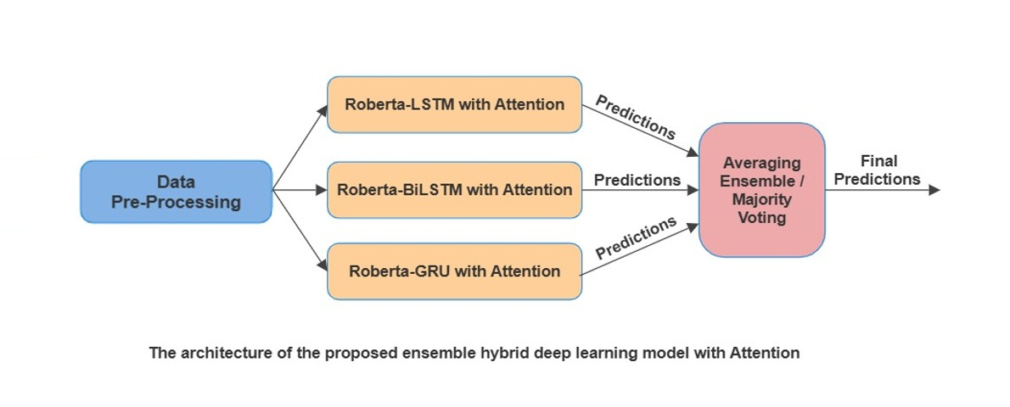
Architecture Diagram

Slide 11
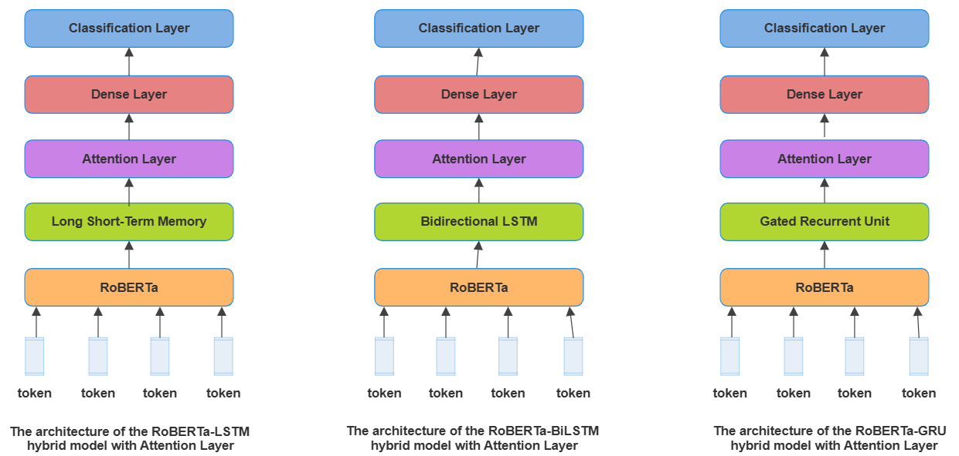
Architecture Diagram

Slide 12
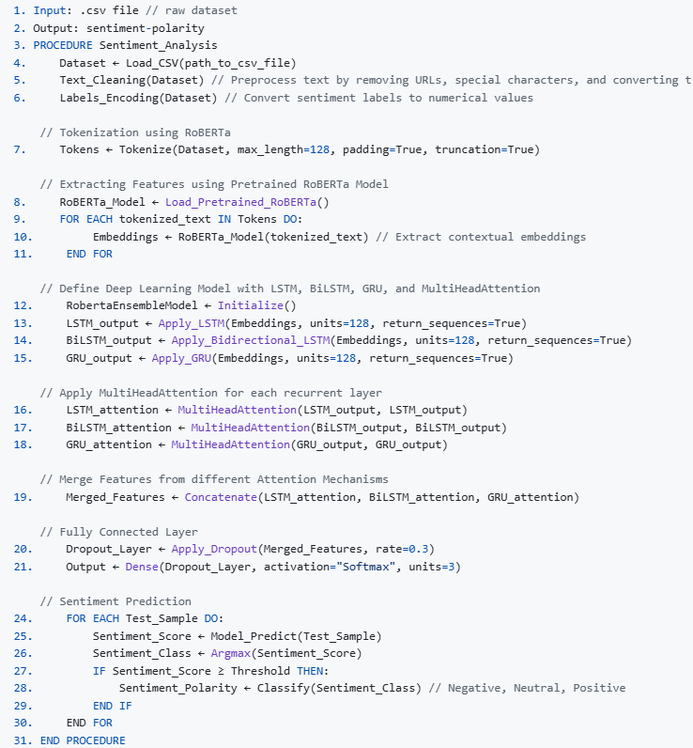
Algorithm

Slide 13
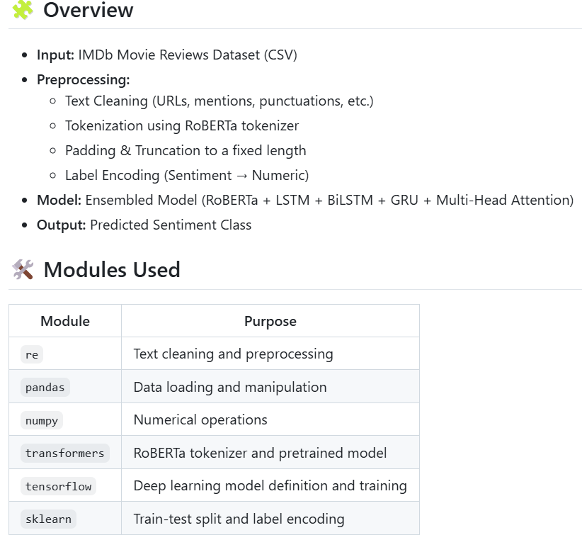
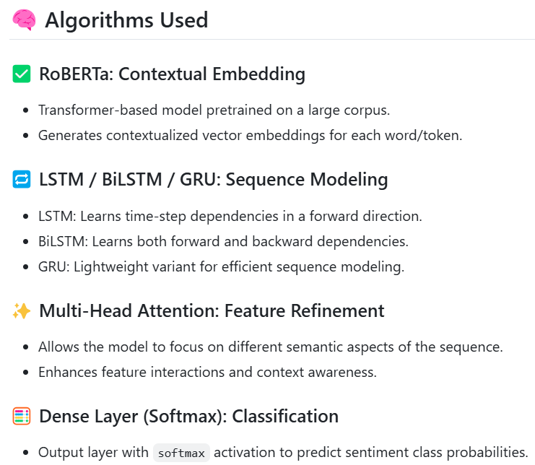
Implementation Details

Slide 14
Executable Software
https://github.com/prudhvitejad/Sentiment-Analysis

Slide 15
References
1. Mohamed, Kentour., Joan, Lu. (2021). 6. An investigation into the deep learning approach in sentimental analysis using graph-based theories. PLOS ONE, doi: 10.1371/JOURNAL.PONE.0260761
2. Nyawa, S., Tchuente, D., & Fosso-Wamba, S. (2024). COVID-19 vaccine hesitancy: a social media analysis using deep learning. Annals of operations research, 339(1), 477-515.
3. (2022). 5. Sentiment Analysis With Ensemble Hybrid Deep Learning Model. IEEE Access, doi: 10.1109/access.2022.3210182
4. Khalid, E. T., Salah Khalefa, M., Yassen, W., & Adil Yassin, A. (2023). Omicron virus emotions understanding system based on deep learning architecture. Journal of Ambient Intelligence and Humanized Computing, 14(7), 9497-9507.
5. Sunitha, D., Patra, R. K., Babu, N. V., Suresh, A., & Gupta, S. C. (2022). Twitter sentiment analysis using ensemble based deep learning model towards COVID-19 in India and European countries. Pattern recognition letters, 158, 164-170.
6. Serpil, Aslan., Soner, Kiziloluk., Eser, Sert. (2023). 3. TSA-CNN-AOA: Twitter sentiment analysis using CNN optimized via arithmetic optimization algorithm. Neural Computing and Applications, doi: 10.1007/s00521-023-08236-2

Slide 16
7. Safak, Kayikci. (2022). 4. SenDemonNet: sentiment analysis for demonetization tweets using heuristic deep neural network. Multimedia Tools and Applications, doi: 10.1007/s11042-022-11929-w
8. Bahdanau, D. (2014). Neural machine translation by jointly learning to align and translate. arXiv preprint arXiv:1409.0473.
9. (2023). Sentiment and Context-Aware Hybrid DNN With Attention for Text Sentiment Classification. IEEE Access, 11:28162-28179. doi: 10.1109/access.2023.3259107
10. (2023). Attention-Based Multi-Channel Gated Recurrent Neural Networks: A Novel Feature-Centric Approach for Aspect-Based Sentiment Classification. IEEE Access, 11:54408-54427. doi: 10.1109/access.2023.3281889

